Slide 1
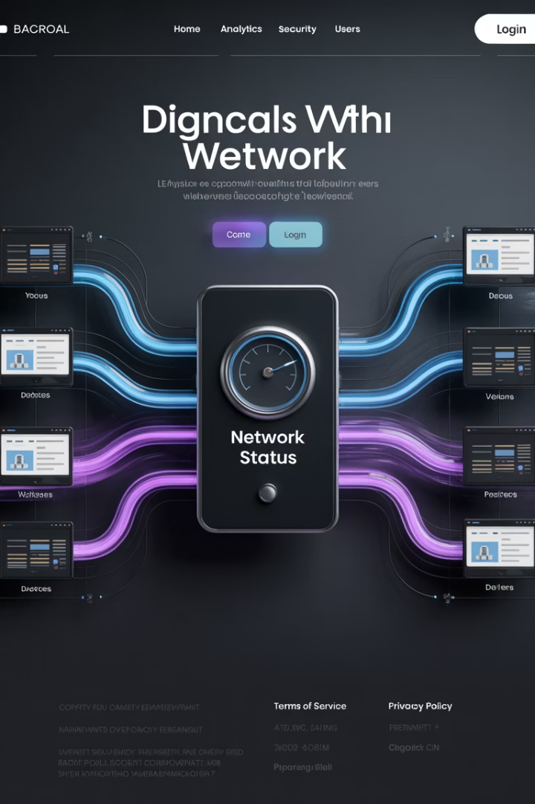
How Does a Website Work?
A website is a collection of webpages, similar to a book with multiple pages. Each webpage can contain different content - text, images, videos, or other elements.
LW
by Liang Wang

Slide 2
What is a Website?
Like a Book
Variable Size
Diverse Content
A website is similar to a book. Its pages are called 'webpages'.
Websites can have one page or thousands of pages.
Each webpage may contain different text, pictures, videos, or other elements.

Slide 3

Web Hosting Explained
Physical Storage
Always Available
Every website exists on a physical computer somewhere in the world.
Hosting servers stay on 24/7 with active internet connections.
Hosting Service
Companies provide space for websites to exist and be accessed continuously through the Uniform Resource Locator or URL.
E.g. https://www.eapservices.co.nz/

Slide 4
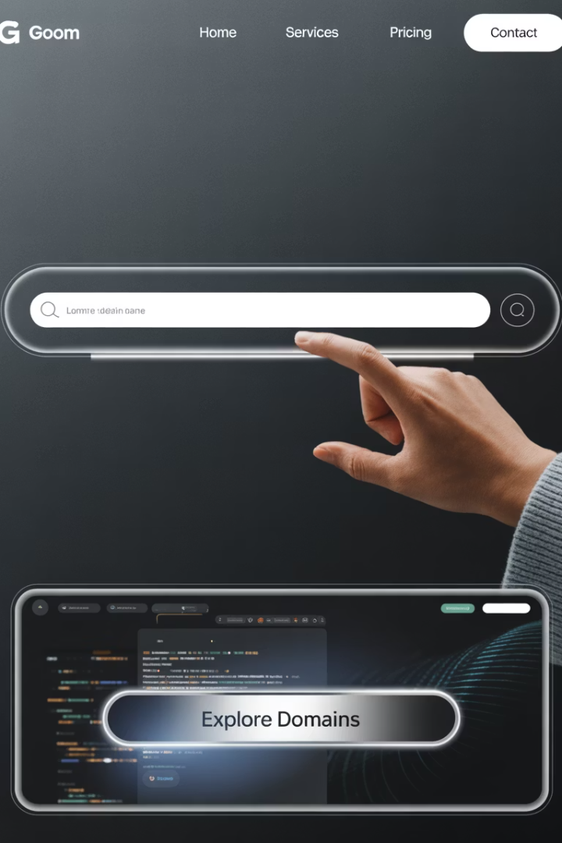



Domain Names
Website Address
Memorable Alternative
Domain names are human-readable addresses for websites.
They replace hard-to-remember IP addresses.
Registration Required
Domain names must be registered with a domain registrar.

Slide 5




DNS Servers
Address Directory
DNS servers act as the internet's address book.
Name Translation
They convert domain names to IP addresses.
Request Routing
DNS directs browser requests to the correct server.

Slide 6
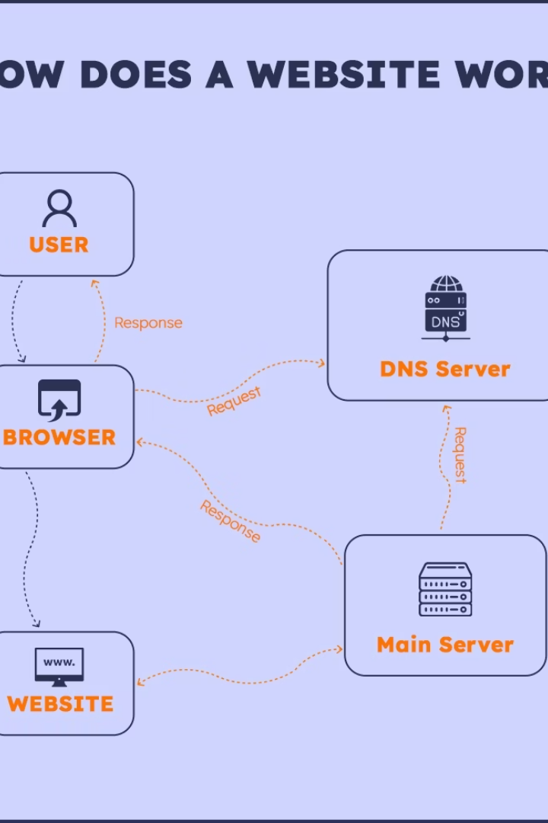
Website Loading Process
Enter Domain Name
User types a website address in the browser's search bar or click a link.
E.g. https://www.eapservices.co.nz/
DNS Translation
DNS server converts the domain name to an IP address.
Server Request
Request goes to the hosting server where the website lives.
Server Response
Server sends website data back to the browser.

Slide 7
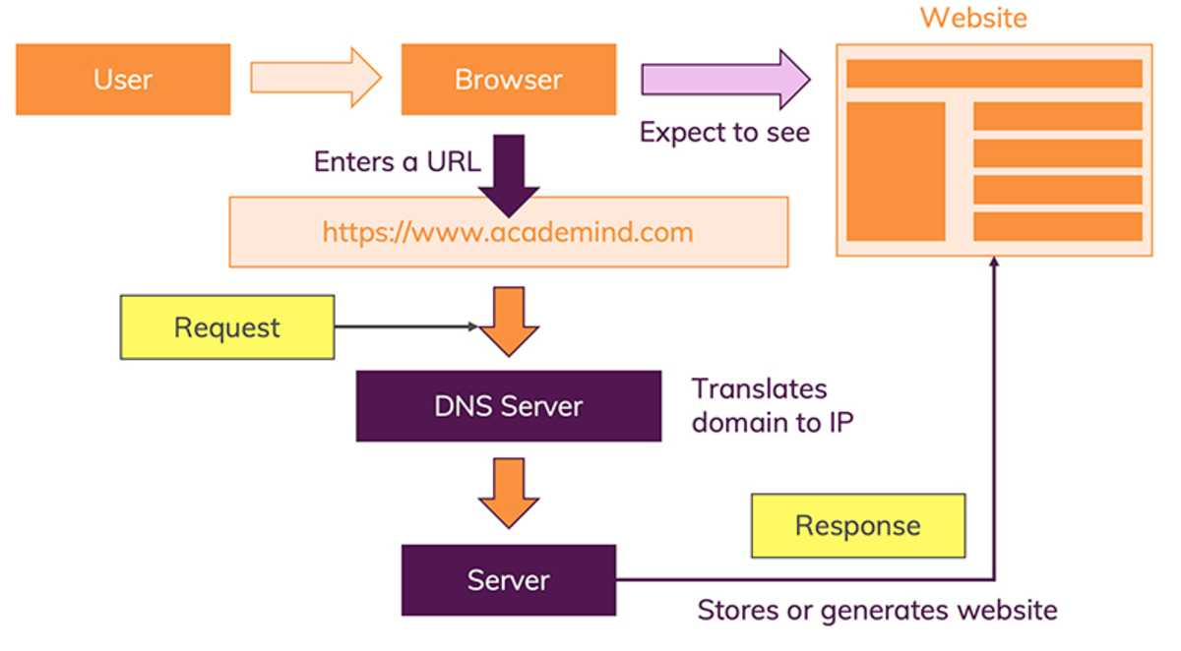
Website Loading Process

Slide 8








The Complete Website Journey
User Request
DNS Lookup
Enter domain in browser
Convert to IP address
Browser Display
Server Processing
Content rendered for user
Website data retrieved

Slide 9





Website Process Summary
User Input
User enters domain name in browser search bar
DNS Translation
Domain converted to IP address
Server Request
Request sent to hosting server
Server Response
Website data sent to browser
Website Display
User views the website

